Slide 1
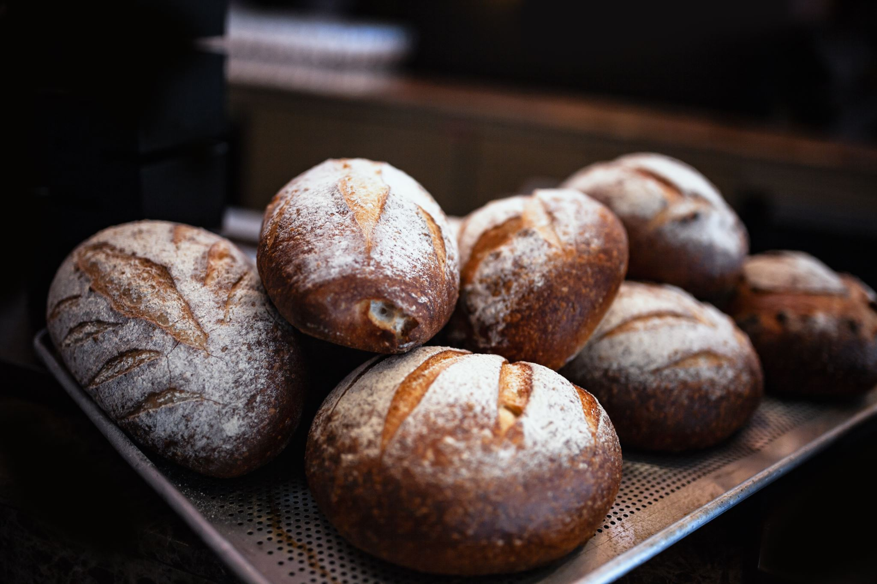
BAKERY MANAGEMENT SYSTEM
GROUP MEMBERS:
Muhammad Mubashir Noor (49331)
Abeerah Shamshad (51722)
Dhara Kumari Rajput (49481)
Muhammad Ali (49632)
Syeda Sumbul Kazmi (49569)

Slide 2
PROJECT OVERVIEW
Our project is a “Bakery Management System”.
This software provides a complete business solution to run a bakery. This system would address all the shop challenges in one integrated system, including inventory, processing, distribution, and accounting. It will be designed to store all information about bakery products, allow for quick product searches, direct reviews, and the creation and management of inventory.

Slide 3
FEATURES OF THE SOFTWARE
The project will include multiple features like add, update, and delete products, billing system, check on stock, and user feedback option.
It will comprise of user interface which will be used to manage products and a database. All the data will be stored in the database manually like item pictures, its name, quantity, flavor, etc. There will be a login panel where the admin of the bakery can manage the bakery items and can see user's feedback. When the admin adds an item to the inventory the database is updated with products quantity and price so that it can be shown inside the system and when a purchase is made a general invoice with the item name and the quantity is created and the quantity of an item purchased will be subtracted from the database. And the system would be able to generate a report about the monthly sales.

Slide 4
SCOPE OF THE PROJECT
Maintain an automated stock handling facility.
Search facilities for quick items.
Provide necessary reports to the customer as well as administrator of the bakery.
Monthly, daily, weekly current stock values.
Allow to add, update, delete any bakery item.
Keep the records of daily bakery process.

Slide 5
METHODS, TOOLS, AND TECHNIQUES
Dia tool will be used to do the UML & for ERD modeling.
The system will be implemented in Java and the development IDE to be used is Eclipse.
Our project team is using WhatsApp group for easy team member communication.
All project documents will be posted on our team group and will be reviewed by every member.

Slide 6
FUNCTIONAL REQUIREMENTS
The system shall provide a convenient interface for User Registration, Product Categories, Items Search, and Payment.
A guest user can only view items. For any kind of shopping, he/she must have registered.
The system should be able to show bakery products in their respective categories.
The system shall be capable to generate invoice bills.
The system shall provide a Password Recovery facility through the customer's email id.
The system shall provide diﬀerent options for sales (10%, 15%, and 20%) on various bakery items.

Slide 7
FUNCTIONAL REQUIREMENTS
If an item is not available (out of stock), and a customer selects it, an alert should be shown to the customer that this item is out of stock. Managing your stock eﬃciently is required for this task.
The search interface shall be convenient to search for any bakery item.
Every order shall be allocated a unique identiﬁer (ORDER_ID).
The systems shall have both admin and user views. i.e., Administrator View and User View.
The customer should be able to order a personalized cake.

Slide 8
NON-FUNCTIONAL REQUIREMENTS
The system must calculate the price of the order of product.
The system should process the order of the bakery in real-time.
The system design should be responsive.
The system must be friendly, and any person can understand the process of the system. Well form interfaces, help guides will be the advantage of usability.

Slide 9
NON-FUNCTIONAL REQUIREMENTS
The products are stored in the database so that the user can easily see its product list.
The admin will be able to see the sales report in the report section which includes daily, monthly & total reports.
The user can also export these reports in excel format.

Slide 10
HOW TEAM IS CREEPING REQUIREMENTS:
We have chosen Agile development Model for our project.
At every stage we will test our product scope and get feedback from our client.
Compare actual work performance measurements with the baseline scope.
Encapsulate fields to secure software.
Applying usability rules so it’ll be open to change at anytime.
Listen to user feedback and decide whether corrective or preventive action is needed.
Managing all change requests and recommended actions.

Slide 11
WHY OUR PROJECT WILL BE BEST?
We will develop our project by taking reviews of our client so it will gradually be developed as per the client’s requirements.
We will divide development into small sprints.
Our team will work in parallel, and all the sprints will be completed on time and feedback will be taken from users after every sprint that will be the main reason to ensure product quality.
The product will be efficient, effective, easy to use, and it will cater to all the client’s requirements.

Slide 12
THANK YOU!

